Slide 1


Jonathan M Clark
2023-01-07

Slide 2

Outline
Executive Summary
Introduction
Methodology
Results
Conclusion
Appendix

Slide 3
Executive Summary
Summary of methodologies
Data was collected from the SpaceX public API and publically available data on Wikipedia. Data wrangling included extracting launch outcome information to serve as the dependent variable in the Machine Learning models.
SQL queries and data visualizations (static plots, interactive maps, and an interactive dashboard) were created to discover insights about the data set and answer questions.
Predictive analysis was pursued using Logistic Regression, SVM (Support Vector Machine), Decision Tree, and KNN (k-Nearest Neighbors) Machine Learning models.
Summary of all results
Launch data include info about flight number, date of launch, payload mass, orbit type, launch site, mission outcome and other variables.
Logistic Regression, SVM (Support Vector Machine), and KNN (k-Nearest Neighbors) all perform equally well for Machine Learning models on this dataset.

Slide 4
Introduction
In competition with SpaceX, a rival rocket launch company wants to make predictions about the success/failure of SpaceX Falcon 9 rocket first stage landings.
What is the nature and extent of the data that we have on SpaceX Falcon 9 first stage landings?
Which machine learning model would work best (have the highest accuracy) to predict the outcome of a Falcon 9 first stage landing from a future launch?
Will a future Falcon 9 first stage landing be successful?

Slide 5

Section 1

Slide 6
Methodology
Executive Summary
SpaceX API and Wikipedia launch table data was collected.
Data was cleaned in preparation for visualizations, queries and machine learning model creation.
Exploratory data analysis (EDA) was done using visualization and SQL.
Interactive visual analytics were created using Folium and Plotly Dash.
Predictive analysis using classification models was done.

Slide 7
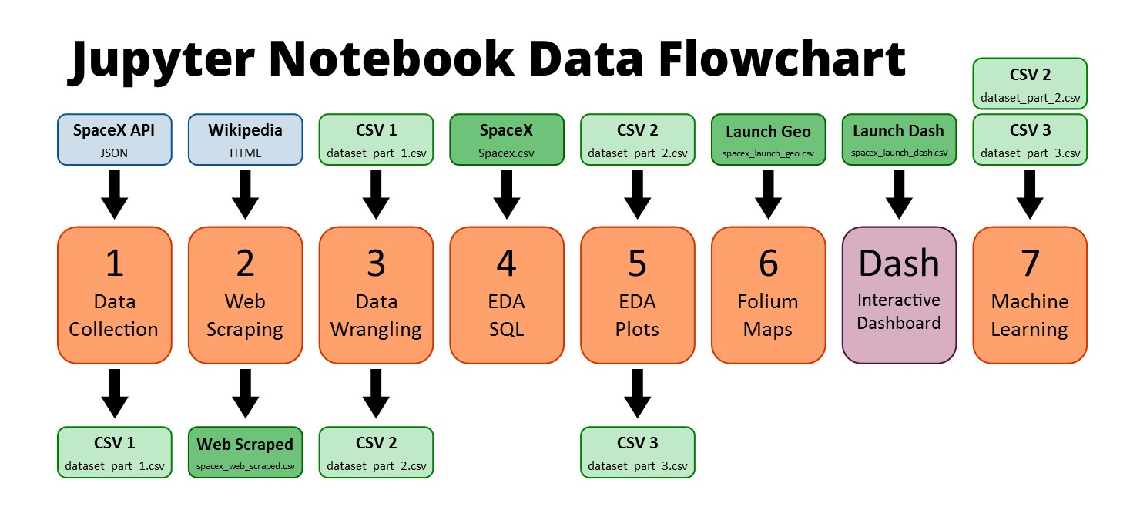
Data Collection
The data sets were collected from:
An IBM copy of a call to the publically accessible SpaceX API with launch data in JSON format.
A permanently linked Wikipedia page with launch data in HTML tables (9 June 2021 revision).
Further data sets were provided. See darker green .csv files in top row of diagram below.

Slide 8
Data Collection – SpaceX API
The SpaceX API has data available publically.
Once a GET request has been made to the SpaceX API and the response received, the data can be placed into a Pandas DataFrame for further analysis.
GitHub URL (Data Collection):
https://github.com/JonathanMClark/DataScienceCapstone/blob/main/1_Capstone_JonathanMClark_Data_Collection.ipynb
Flowchart of SpaceX API Calls
Place call to API
Extract nested data and convert date format
Use defined functions to generate specific columns of data
Combine separate columns into a DataFrame
Filter out all launches with rockets other than the Falcon 9
Handle missing values
19.05 cm

Slide 9
Data Collection - Scraping
Wikipedia has a page that has tables of data about SpaceX launches.
These tables can be scraped to extract launch data that can be put into a Pandas DataFrame for further analysis.
GitHub URL (Web Scraping):
https://github.com/JonathanMClark/DataScienceCapstone/blob/main/2_Capstone_JonathanMClark_Webscraping.ipynb
Flowchart of Web Scraping
Web Scrape the page to get the HTML text
Create a BeautifulSoup object from the response text content
Find the tables
From the launch table, extract the column names from the <th></th> tags
Create DataFrame by parsing the launch tables

Slide 10
Data Wrangling
The .csv file from the first section contains the data that needed to be cleaned.
The launch sites, orbit types and mission outcomes were cleaned up.
The handful of mission outcome types were converted to a binary classification where 1 means that the Falcon 9 first stage landing was a success and 0 means that it was a failure.
The new classification was added to the DataFrame for further analysis
GitHub URL (Data Wrangling):
https://github.com/JonathanMClark/DataScienceCapstone/blob/main/3_Capstone_JonathanMClark_Data_Wrangling.ipynb
Flowchart of Data Wrangling
Load .csv data from earlier section
Find the number of launches at each site
Find the number of each type of orbit
Find the number of each type of mission outcome
Create a DataFrame column from the outcome data
Compile everything into a DataFrame

Slide 11
EDA with Data Visualization
The following charts were created to look at Launch Site trends
Scatterplot to see mission outcome relationship split by Launch Site and Flight Number.
Scatterplot to see mission outcome relationship split by Launch Site and Payload.
The following charts were created to look at Orbit Type trends
Bar chart to see mission outcome relationship with Orbit Type.
Scatterplot to see mission outcome relationship split by Orbit Type and Flight Number.
Scatterplot to see mission outcome relationship split by Orbit Type and Payload.
The following chart was created to look at trends based on time
Line plot to see mission outcome trend by year.
GitHub URL (EDA with Data Visualization):
https://github.com/JonathanMClark/DataScienceCapstone/blob/main/5_Capstone_JonathanMClark_EDA_Data_Visualization.ipynb

Slide 12
EDA with SQL
Queries were written to extract information about:
Launch sites
Payload masses
Dates
Booster types
Mission outcomes
GitHub URL (EDA with SQL):
https://github.com/JonathanMClark/DataScienceCapstone/blob/main/4_Capstone_JonathanMClark_EDA_SQL.ipynb

Slide 13
Build an Interactive Map with Folium
Summarize what map objects such as markers, circles, lines, etc. you created and added to a folium map
Markers were added for launch sites and for the NASA Johnson Space Center
Circles were added for the launch sites.
Lines were added to show the distance to the nearby features:
Distance from CCAFS LC-40 to the coastline
Distance from CCAFS LC-40 to the rail line
Distance from CCAFS LC-40 to the perimeter road
GitHub URL (Folium Maps):
https://github.com/JonathanMClark/DataScienceCapstone/blob/main/6_Capstone_JonathanMClark_Launch_Site_Location.ipynb

Slide 14
Build a Dashboard with Plotly Dash
The input dropdown is used to select one or all launch sites for the pie chart and scatterplot.
The pie chart displays one of two things:
For All Sites – the distribution of successful Falcon 9 first stage landings between the sites
For One Site – the distribution of successful and failed Falcon 9 first stage landings for that site
The input slider is used to filter the payload masses for the scatterplot.
The scatterplot displays the distribution of Falcon 9 first stage landings split by payload mass, mission outcome and by booster version category.
GitHub URL (Dashboad File):
https://github.com/JonathanMClark/DataScienceCapstone/blob/main/JonathanMClark_spacex_dash_app.py

Slide 15
Predictive Analysis (Classification)
The dataset was split into training and testing sets.
Logistic Regression, SVM (Support Vector Machine), Decision Tree, and KNN (k-Nearest Neighbors) machine learning models were trained on the training data set.
Hyper-parameters were evaluated using GridSearchCV() and the best was selected using ‘.best_params_’.
Using the best hyper-parameters, each of the four models were scored on accuracy by using the testing data set.
GitHub URL (Machine Learning): https://github.com/JonathanMClark/DataScienceCapstone/blob/main/7_Capstone_JonathanMClark_Machine_Learning_Prediction.ipynb
Flowchart of Machine Learning
DataFrame was created with the cleaned data
The data was split into training and testing sets
Each of four models were trained on the training data set
Each of four models were evaluates on the testing data set
Models were compared based on accuracy scores

Slide 16
Results
Exploratory data analysis results
Interactive analytics demo in screenshots
Predictive analysis results

Slide 17

Section 2

Slide 18
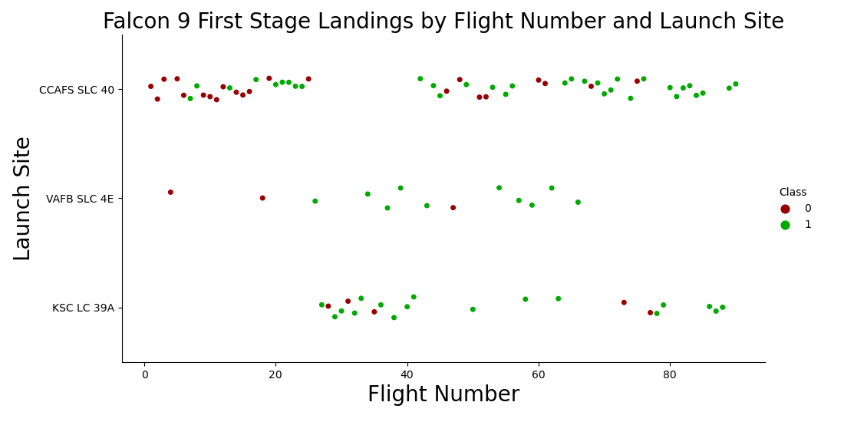
Flight Number vs. Launch Site
Success rate varies noticeably with launch site.
Successful Falcon 9 first stage landings appear to become more prevalent as the flight number increases.
Falcon 9 first stage failed landings are indicated by the ‘0’ Class (● red markers) and successful landings by the ‘1’ Class (● green markers).

Slide 19
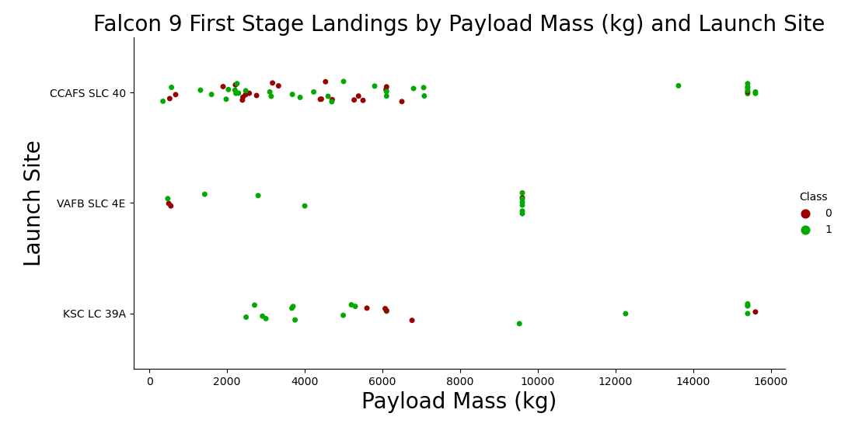
Payload vs. Launch Site
For the CCAFS SLC 40 launch site, the payload mass and the landing outcome appear to not be strongly correlated.
The failed landings at the KSC LC 39A launch site are all grouped around a narrow band of payload masses.
Falcon 9 first stage failed landings are indicated by the ‘0’ Class (● red markers) and successful landings by the ‘1’ Class (● green markers).

Slide 20
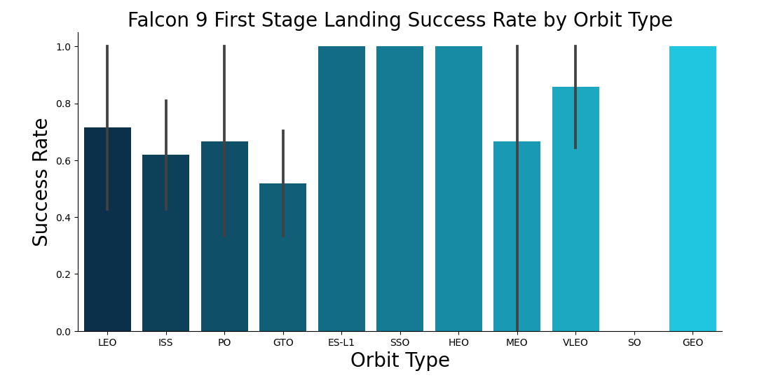
Success Rate vs. Orbit Type
ES-L1, SSO, HEO and GEO orbits have no failed first stage landings.
SO orbits have no successful first stage landings.

Slide 21
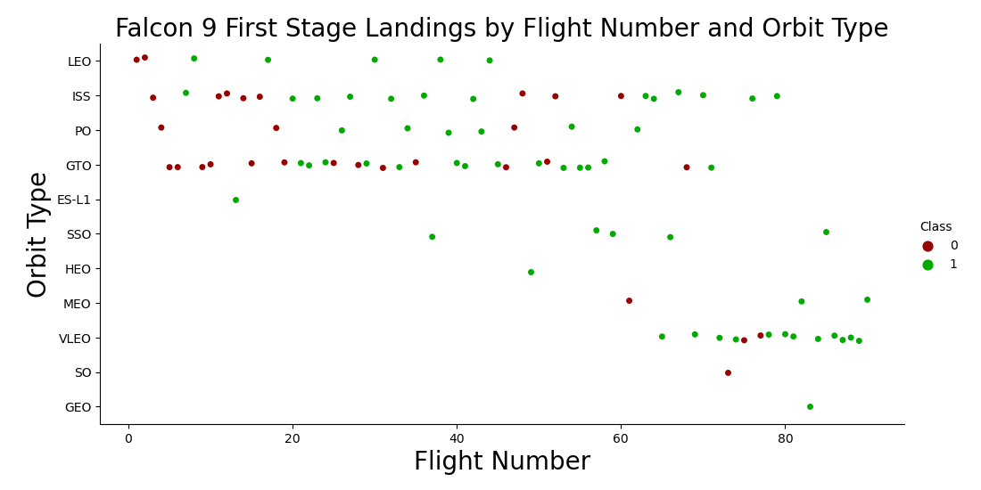
Flight Number vs. Orbit Type
There is a correlation between flight number and success rate with larger flight numbers being associated with higher success rates.

Slide 22
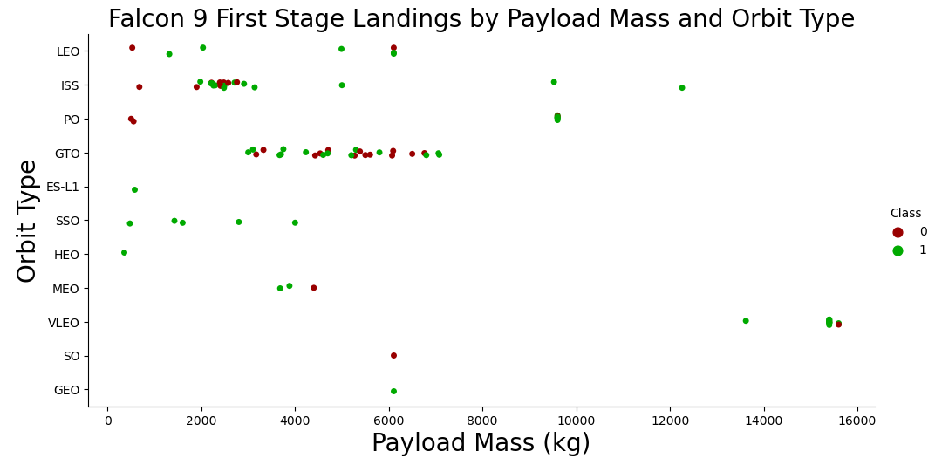
Payload vs. Orbit Type
Some orbit types have better success rates than others.
Success rate appears to have no obvious correlation with payload mass.

Slide 23
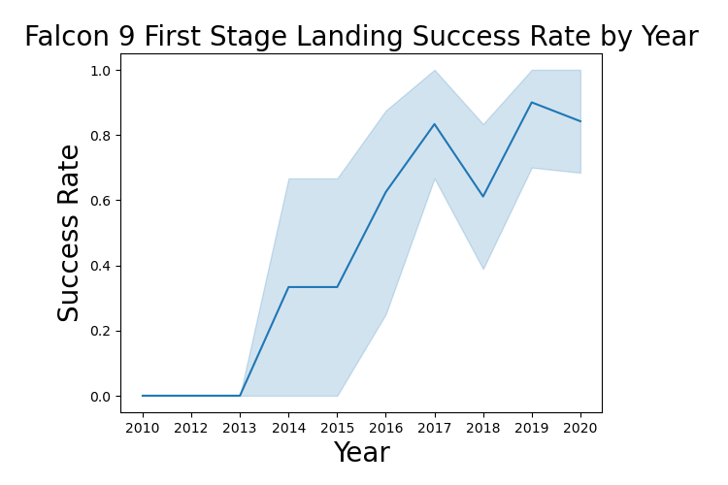
Launch Success Yearly Trend
The success rate has increased significantly over the years.

Slide 24
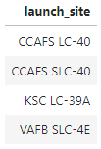
All Launch Site Names
Question: What are the names of the unique launch sites?
Query:
Result:
Explanation: There are four unique launch sites.
SELECT DISTINCT LAUNCH_SITE FROM SPACEXDATASET;

Slide 25
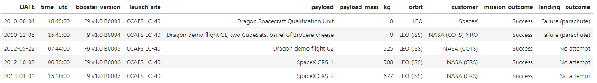
Launch Site Names That Begin with 'CCA'
Task: Find 5 records with launch sites that begin with `CCA`.
Query:
Result:
Explanation: This is a fairly straightforward sampling mechanism used to gain a sense of the data contained in the database table.
SELECT * FROM SPACEXDATASET WHERE launch_site LIKE 'CCA%' LIMIT 5;

Slide 26
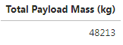
Total Payload Mass
Question: What is the total payload carried by boosters from NASA?
Query:
Result:
Explanation: The total payload carried by boosters from NASA is 48,213 kg.
SELECT sum(payload_mass__kg_) AS "Total Payload Mass (kg)" FROM SPACEXDATASET WHERE customer LIKE '%NASA (CRS)%';

Slide 27
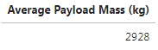
Average Payload Mass by F9 v1.1
Question: What is the average payload mass carried by booster version F9 v1.1?
Query:
Result:
Explanation: The average payload mass carried by booster version F9 v1.1 is 2,928 kg.
SELECT sum(payload_mass__kg_) / count(payload_mass__kg_) AS “Average Payload Mass (kg)" FROM SPACEXDATASET WHERE booster_version LIKE 'F9 v1.1';

Slide 28
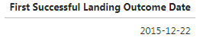
First Successful Ground Landing Date
Question: On which date did the first successful landing outcome on ground pad occur?
Query:
Result:
Explanation: The first successful landing outcome on ground pad occurred on December 22, 2015.
SELECT min(DATE) AS "First Successful Landing Outcome Date" FROM SPACEXDATASET WHERE landing__outcome LIKE ‘Success (ground pad)';

Slide 29
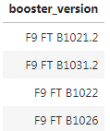
Successful Drone Ship Landing with Payload between 4000 and 6000
Question: What are the names of the boosters which have successfully landed on drone ship and had a payload mass greater than 4000 but less than 6000?
Query:
Result:
Explanation: The four booster versions that have successfully landed on drone ship with a payload mass greater than 4,000 kg but less than 6,000 kg are listed above.
SELECT DISTINCT booster_version FROM SPACEXDATASET WHERE landing__outcome = 'Success (drone ship)' and payload_mass__kg_ BETWEEN 4000 and 6000;

Slide 30
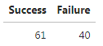
Total Number of Successful and Failure Mission Outcomes
Question: What was the total number of successful and failed mission outcomes?
Query:
Result:
Explanation: There were 61 successful and 40 failed mission outcomes.
SELECT (SELECT count(*) FROM SPACEXDATASET WHERE lcase(landing__outcome) LIKE '%success%') AS "Success“, count(*) AS "Failure" FROM SPACEXDATASET WHERE lcase(landing__outcome) NOT LIKE '%success%';

Slide 31
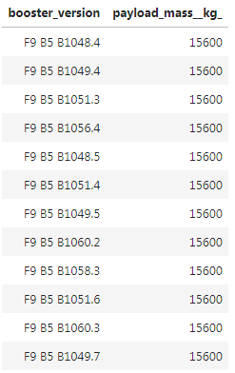
Boosters Carried Maximum Payload
Question: What were the names of the boosters which have carried the maximum payload mass?
Query:
Result:
SELECT booster_version, payload_mass__kg_ FROM SPACEXDATASET WHERE payload_mass__kg_ = (SELECT max(payload_mass__kg_) FROM SPACEXDATASET);
Explanation: The maximum payload mass carried in this dataset is 15,600 kg. Twelve (12) separate Falcon 9 boosters carried this amount of payload mass.

Slide 32
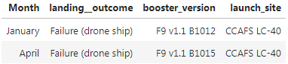
2015 Launch Records
Task: List the failed landing_outcomes in drone ship, their booster versions, and launch site names for records in year 2015.
Query:
Result:
Explanation: There were two failed landing outcomes with a drone ship in 2015. Both launched from CCAFS LC-40. One occurred in January and the other in April.
SELECT MONTHNAME(DATE) AS “Month”, landing__outcome, booster_version, launch_site FROM SPACEXDATASET WHERE landing__outcome = 'Failure (drone ship)' AND YEAR(DATE) = 2015;

Slide 33
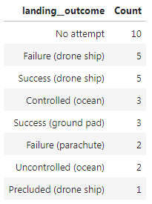
Rank Landing Outcomes Between 2010-06-04 and 2017-03-20
Task: Rank the count of landing outcomes (such as Failure (drone ship) or Success (ground pad)) between the date 2010-06-04 and 2017-03-20, in descending order.
Query:
Result:
Explanation: The most common landing outcome was ‘not attempted’.
SELECT landing__outcome, count(landing__outcome) AS "Count" FROM SPACEXDATASET WHERE DATE BETWEEN '2010-06-04' AND '2017-03-20' GROUP BY landing__outcome ORDER BY count(landing__outcome) DESC;

Slide 34

Section 3

Slide 35
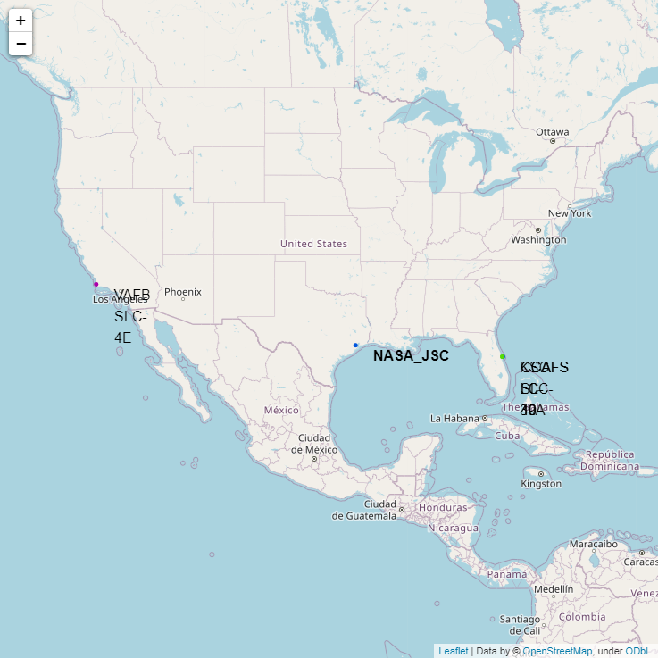
Falcon 9 Launch Site Locations
VAFB SLC-4E (California, USA)
Vandenberg Air Force Base Space Launch Complex 4E
KSC LC-39A (Florida, USA)
Kennedy Space Center Launch Complex 39A
CCAFS LC-40 (Florida, USA)
Cape Canaveral Air Force Station Launch Complex 40
CCAFS SLC-40 (Florida, USA)
Cape Canaveral Air Force Station Space Launch Complex 40

Slide 36
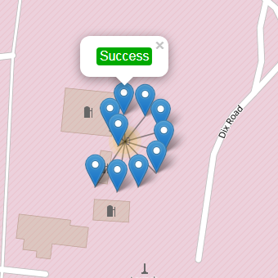
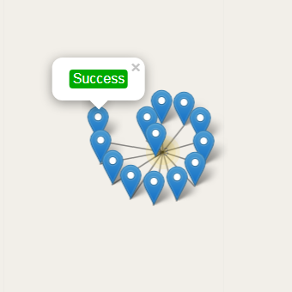
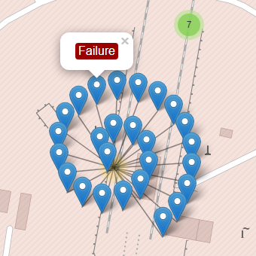
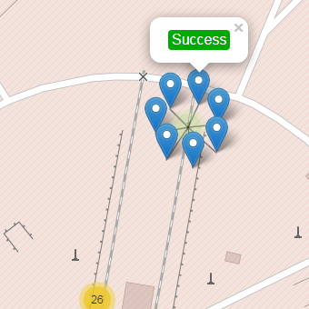
Map Markers of Success/Failed Landings
The markers display the mission outcomes (Success/Failure) for Falcon 9 first stage landings. They are grouped on the map to be associated with the geographical coordinates for the launch site.
A sense of a launch site’s success rate for Falcon 9 first stage landings can be gleaned from the relative number of green success markers to red failure markers.
VAFB SLC-4E
KSC LC-39A
CCAFS LC-40
CCAFS SLC-40

Slide 37
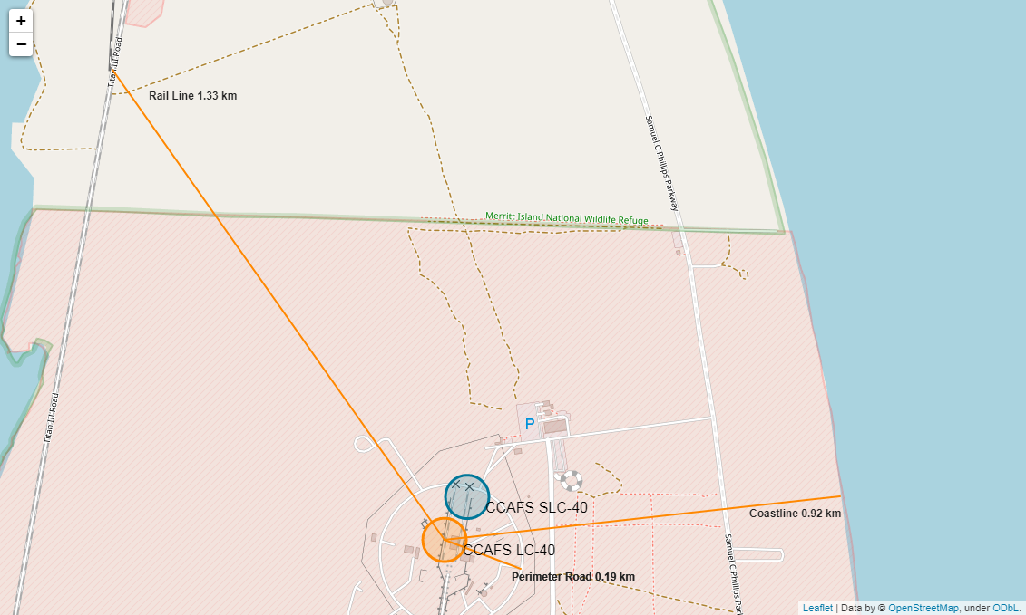
Distance from Launch Site to Proximities
The CCAFS LC-40 and CCAFS SLC-40 launch sites have coordinates that are close to being, but are not exactly, right on top of each other.
The perimeter road around CCAFS LC-40 is 0.19 km away from the launch site coordinates.
The coastline is 0.92 km away from CCAFS LC-40.
The rail line is 1.33 km away from CCAFS LC-40.

Slide 38

Section 4

Slide 39
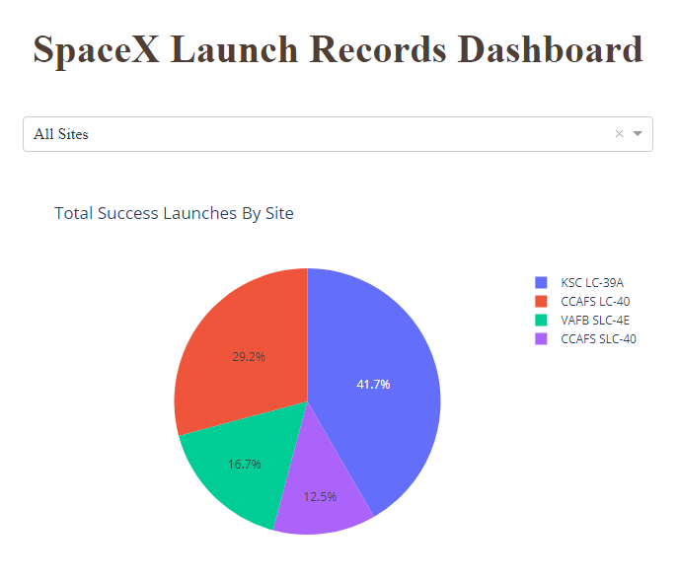
Launch Success Count for All Sites
The dropdown menu allows the selection of one or all launch sites.
With all launch sites selected, the pie chart displays the distribution of successful Falcon 9 first stage landing outcomes between the different launch sites.
The greatest share of successful Falcon 9 first stage landing outcomes (at 41.7% of the total) occurred at KSC LC-39A.

Slide 40
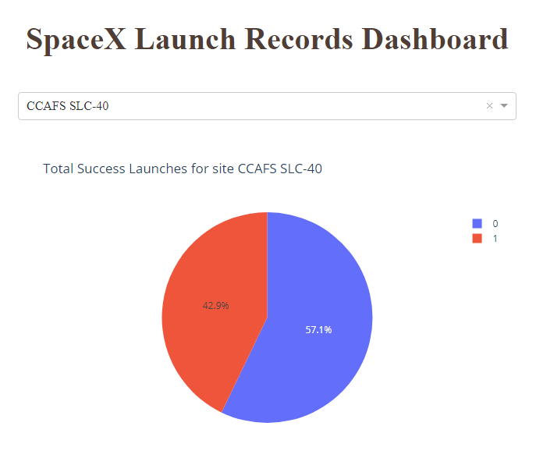
Launch Site with Highest Launch Success Ratio
Falcon 9 first stage failed landings are indicated by the ‘0’ Class (■ blue wedge in the pie chart) and successful landings by the ‘1’ Class (■ red wedge in the pie chart).
CCAFS SLC-40 was the launch site that had the highest Falcon 9 first stage landing success rate (42.9%).

Slide 41
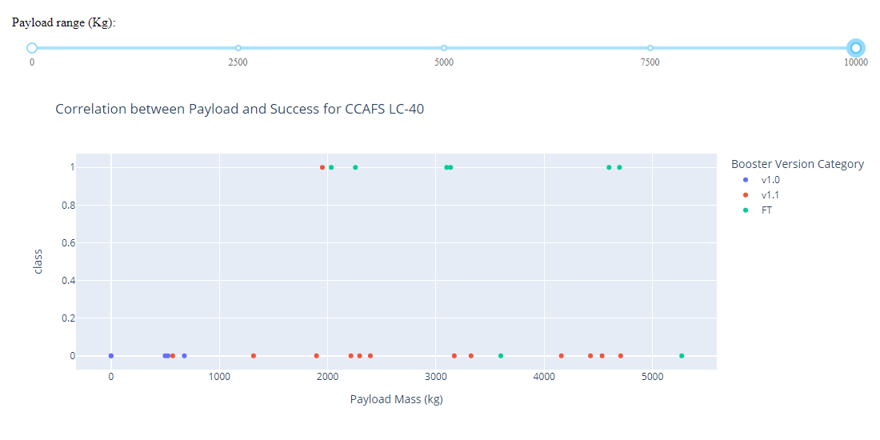
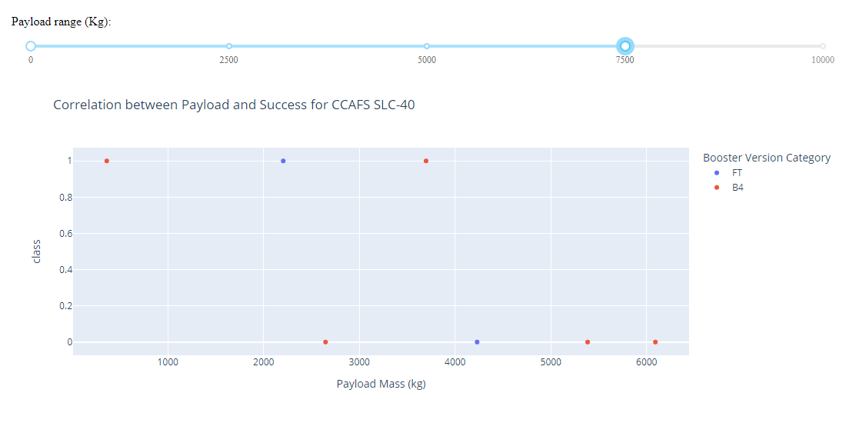
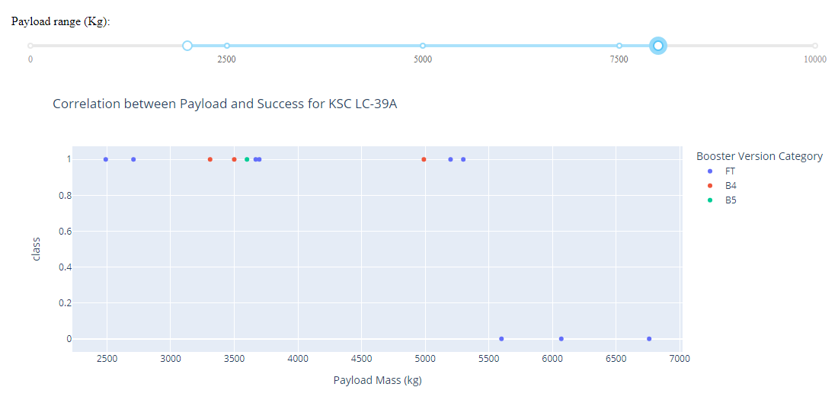
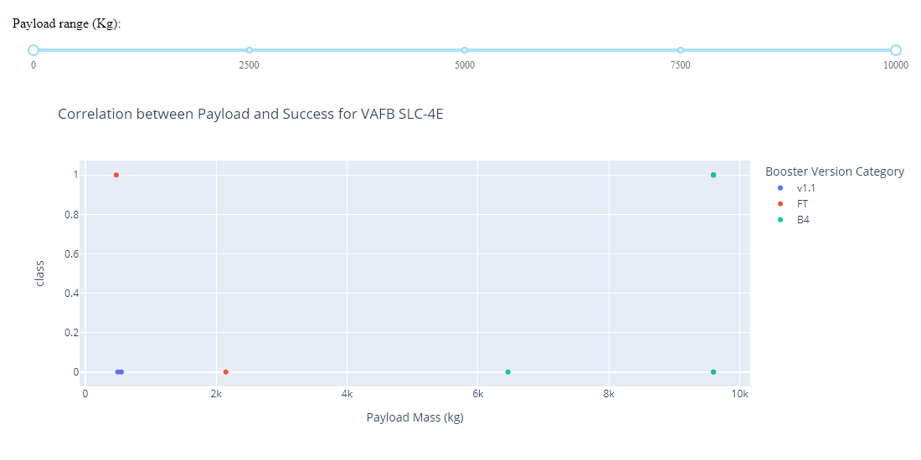
Payload vs. Launch Outcome
These screenshots are of the Payload vs. Launch Outcome scatter plots for all sites, with different payload selected in the range slider.
The payload range from about 2,000 kg to 5,000 kg has the largest success rate.
The ‘FT’ booster version category has the largest success rate.
CCAFS LC-40
CCAFS SLC-40
KSC LC-39A
VAFB SLC-4E

Slide 42

Section 5

Slide 43
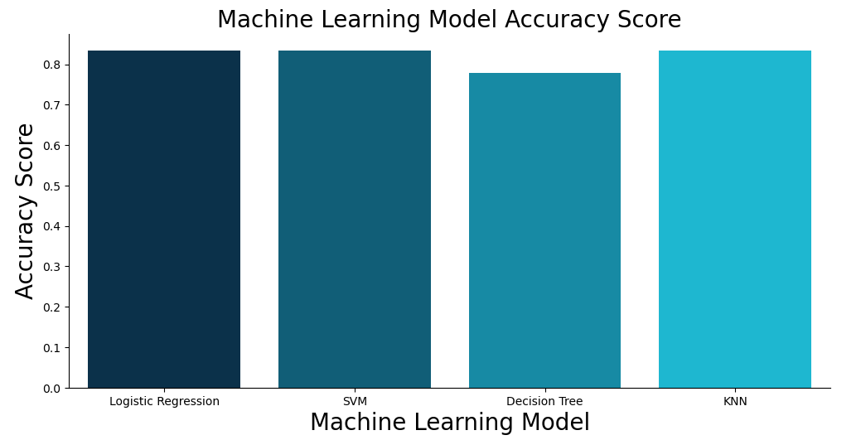
Classification Accuracy
All models performed equally well except for the Decision Tree model which performed poorly relative to the other models.

Slide 44
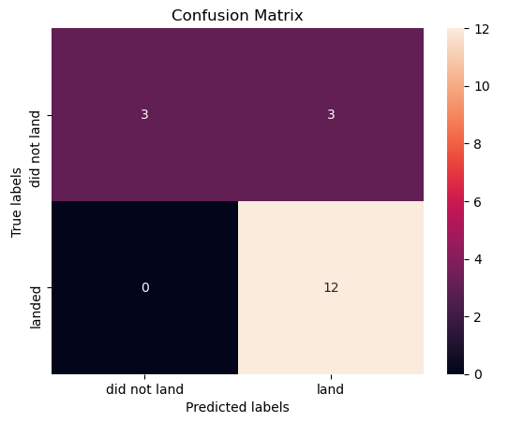

Confusion Matrix
Shown here is the confusion matrix for the Logistic Regression model.
Confusion matrices can be read as:
Prediction Breakdown:
12 True Positives and 3 True Negatives
3 False Positives and 0 False Negatives

Slide 45
Conclusions
SpaceX does not have a perfect track record of Falcon 9 first stage landing outcomes.
SpaceX’s Falcon 9 first stage landing outcomes have been trending towards greater success as more launches are made.
The machine learning models can be used to predict future SpaceX Falcon 9 first stage landing outcomes.

Slide 46
Appendix
Initial Data Sets
SpaceX API (JSON): https://cf-courses-data.s3.us.cloud-object-storage.appdomain.cloud/IBM-DS0321EN-SkillsNetwork/datasets/API_call_spacex_api.json
Wikipedia (Webpage): https://en.wikipedia.org/w/index.php?title=List_of_Falcon_9_and_Falcon_Heavy_launches&oldid=1027686922
SpaceX (CSV): https://cf-courses-data.s3.us.cloud-object-storage.appdomain.cloud/IBM-DS0321EN-SkillsNetwork/labs/module_2/data/Spacex.csv?utm_medium=Exinfluencer&utm_source=Exinfluencer&utm_content=000026UJ&utm_term=10006555&utm_id=NA-SkillsNetwork-Channel-SkillsNetworkCoursesIBMDS0321ENSkillsNetwork26802033-2022-01-01
Launch Geo (CSV): https://cf-courses-data.s3.us.cloud-object-storage.appdomain.cloud/IBM-DS0321EN-SkillsNetwork/datasets/spacex_launch_geo.csv
Launch Dash (CSV): https://cf-courses-data.s3.us.cloud-object-storage.appdomain.cloud/IBM-DS0321EN-SkillsNetwork/datasets/spacex_launch_dash.csv
Data Sets (.csv files)
GitHub URL (CSV 1): https://github.com/JonathanMClark/DataScienceCapstone/blob/main/dataset_part_1.csv
GitHub URL (Web Scraped): https://github.com/JonathanMClark/DataScienceCapstone/blob/main/spacex_web_scraped.csv
GitHub URL (CSV 2): https://github.com/JonathanMClark/DataScienceCapstone/blob/main/dataset_part_2.csv
GitHub URL (SpaceX): https://github.com/JonathanMClark/DataScienceCapstone/blob/main/Spacex.csv
GitHub URL (CSV 3): https://github.com/JonathanMClark/DataScienceCapstone/blob/main/dataset_part_3.csv
GitHub URL (Launch Geo): https://github.com/JonathanMClark/DataScienceCapstone/blob/main/spacex_launch_geo.csv
GitHub URL (Launch Dash): https://github.com/JonathanMClark/DataScienceCapstone/blob/main/spacex_launch_dash.csv

Slide 47
Appendix
Jupyter Notebooks and Dashboard Python File
GitHub URL (Data Collection): https://github.com/JonathanMClark/DataScienceCapstone/blob/main/1_Capstone_JonathanMClark_Data_Collection.ipynb
GitHub URL (Web Scraping): https://github.com/JonathanMClark/DataScienceCapstone/blob/main/2_Capstone_JonathanMClark_Webscraping.ipynb
GitHub URL (Data Wrangling): https://github.com/JonathanMClark/DataScienceCapstone/blob/main/3_Capstone_JonathanMClark_Data_Wrangling.ipynb
GitHub URL (EDA with SQL): https://github.com/JonathanMClark/DataScienceCapstone/blob/main/4_Capstone_JonathanMClark_EDA_SQL.ipynb
GitHub URL (EDA with Data Visualization): https://github.com/JonathanMClark/DataScienceCapstone/blob/main/5_Capstone_JonathanMClark_EDA_Data_Visualization.ipynb
GitHub URL (Folium Maps): https://github.com/JonathanMClark/DataScienceCapstone/blob/main/6_Capstone_JonathanMClark_Launch_Site_Location.ipynb
GitHub URL (Dashboad File): https://github.com/JonathanMClark/DataScienceCapstone/blob/main/JonathanMClark_spacex_dash_app.py
GitHub URL (Machine Learning): https://github.com/JonathanMClark/DataScienceCapstone/blob/main/7_Capstone_JonathanMClark_Machine_Learning_Prediction.ipynb

Slide 48


